Slide 1
FTC &Me
Are you and your GPL in compliance?

Slide 2
What to expect from today’s training
What is the purpose of this training?
What will you get out of this when we are done?
Before we get started,
who here knows what the FTC fine is for every violation?

Slide 3

Recent Activity by the FTC
Late 2024 the FTC conducted over 250 undercover calls to random funeral homes.
39 funeral homes were issued warnings.
  38 funeral homes allegedly refused or provided conflicting pricing information.
  1 funeral home claimed that embalming was legally required.
  1 funeral home failed to provide a proper GPL, offering only incomplete pricing details.

Slide 4
QUIZ TIME
As of January 2025 what is the fine for unresolved violations?
$51,744.00

Slide 5

Let’s talk!
FTC requirements

Slide 6



What is a “triggering event”?
By phone
In-person
Out in public

Slide 7

BY PHONE
Who can give prices?
Offering a GPL
Anonymity

Slide 8

IN-PERSON
Where are your GPLs kept
Everyone must know where they are and be able to hand them out once “triggered”.

Slide 9
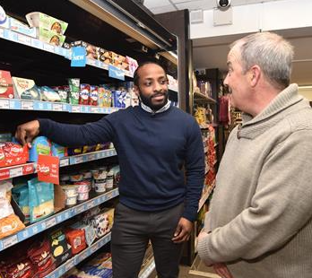
PUBLIC PLACES
What to do.
Offer you card, ask them to call or stop by.
Offer to mail the GPL

Slide 10
What’s on your GPL?

Slide 11

Identifying information
Name, address, and telephone number of the funeral provider.
Address and phone numbers of EACH branch
The caption: “General Price List”
Effective date

Slide 12
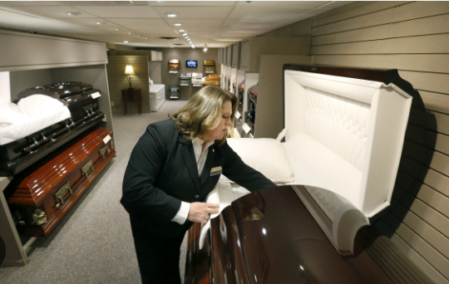
Required Disclosures
The consumer’s right to select only the goods and services desired.
Embalming
Alternative containers for direct cremation
The basic service fee
The Casket Price List
The outer Burial Container Price List

Slide 13
Required Itemized Prices on the GPL
1. Forwarding of remains to another funeral home
2. Receiving remains from another funeral home
3. Direct cremation
4. Immediate burial
5. Basic services of funeral director and staff, and overhead
6. Transfer of remains to funeral home
7. Embalming
8. Other preparation of the body
9. Use of facilities and staff for viewing
10. Use of facilities and staff for funeral ceremony
11. Use of facilities and staff for memorial service
12. Use of equipment and staff for graveside service
13. Hearse
14. Limousine
15. Either individual casket prices or the range of casket prices that appear on the Casket Price List
16. Either individual outer burial container prices or the range of outer burial container prices that appear on the Outer Burial Container Price List You can list these items in any order you want.
You only have to list the items that you actually offer. If you do not offer one or more of the 16 items, you need not list those items on the General Price List.

Slide 14
QUIZ TIME
TRUE OR FALSE
If you do not own a limo, you still need to put it on your price list.
FALSE

Slide 15
QUIZ TIME
Multiple Choice
Which item does not need to be included on your GPL?
The phrase: “General Price List”
The manager’s name
The effective date
The phone number
B

Slide 16
QUIZ TIME
How long must you retain
an outdated GPL?
1 year from the date of expiration

Slide 17
In conclusion
The FTC is continuing their undercover calls.
The current violation cost is $51,744.00 for EACH violation
…and remember the FTC Funeral Rule is in place to protect you and the consumer!

Slide 18
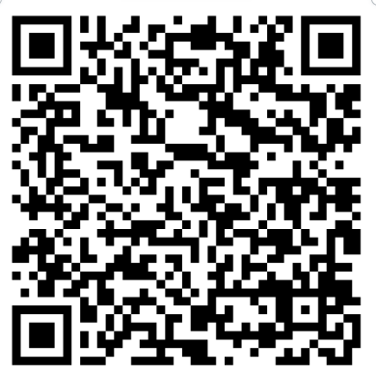
Beneficial Resources
FTC – Complying with the Funeral Rule

Slide 19
What’s next?
Keep a look out for a continuation
of this series with topics like:
Statement of Goods and Services: Is my statement “GOOD” and compliant with the FTC Funeral Rule?
Special GPLs: How special are they and are they compliant?
“My loved one has passed away, what are my consumer rights”? (Directed towards the general public)

Slide 20
Sources
https://www.ftc.gov/news-events/topics/truth-advertising/green-guides
www.tributetech.com

Slide 21
Thank you!
Question & Answer

